Slide 1
IB Diploma program
International Baccalaureate
Avi Snyder
IB Diploma Coordinator
Social Studies and English Teacher

Slide 2
WHAT is the IB diploma program?
A rigorous two-year program for 11th and 12th graders.
Students take all their classes at the IB level, which carries a 1.2 weight (like AP) and is eligible for college placement or credit.
In addition to individual course credits, students who successfully complete the program can achieve an IB Diploma, which is an international qualification.

Slide 3
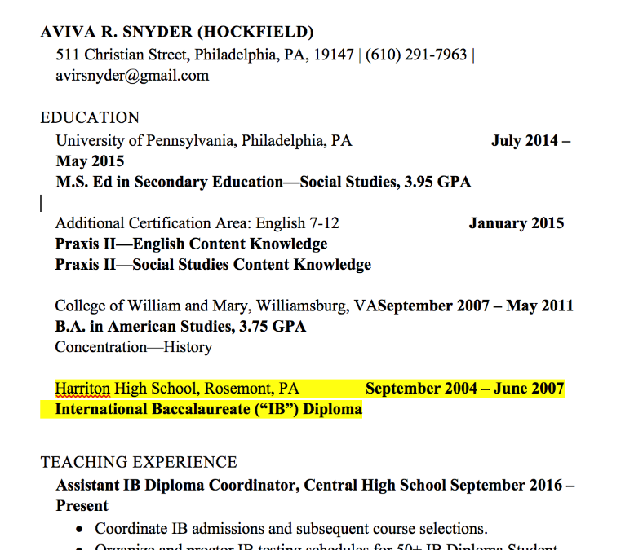
WHO is IB for?
IB is a two year program for juniors and seniors. Students apply in the spring of their sophomore year.
IB is for students who want to challenge themselves by taking rigorous college-level classes in every subject.
IB is for students who want to think critically about what they are learning instead of just filling in bubbles.
IB is for students who love finding connections between their subjects instead of study subjects in isolation.
IB is for students who can work independently and have strong time management skills. (If they’re not there yet, they sure will learn!)

Slide 4
What do Central IB students say?
“You have smaller class sizes and stronger relationships with your classmates.”
“You have stronger relationships with your teachers as well.”
“Getting college recommendations is a breeze”
“Teachers plan together.”
“The Coordinator acts as your personal academic advisor.”
“It’s not multiple choice—it makes you think!”
“You really learn to write a research paper.”
“Gives you a chance to connect things together and use the knowledge you gain.”

Slide 5
What is the IB core?
All students in the IB Program participate in 3 core learning experiences:
The Theory of Knowledge class, in which they will investigate where knowledge comes from!
The Extended Essay: Students write 4000-word research paper on a topic of their interest!
Creativity, Action, and Service: Learn outside the classroom and reflecting on their personal growth through these activities.

Slide 6
What classes will they take?
The Six Academic Areas
Group 1: Studies in Language and Literature ("English”)
Group 2: Language Acquisition ("World Language”) (3 difficulty levels)
Group 3: Individuals and Societies ("Social Studies”)
Group 4: Mathematics (3 difficulty levels)
Group 5: Sciences
Group 6: The Arts
Students are required to choose one subject from each of Groups 1-5, and a sixth class from any group.
Three classes are taken “Higher Level” (2-years) and three are taken at “Standard Level” (1-year); all are rigorous and carry the 1.2 weight.

Slide 7
IB Course Offerings
Group 1: Studies in Literature IB English HL (required) Group 2: Language Acquisition French HL/SL Italian SL Latin SL Mandarin SL Spanish HL/SL **HL language students have an extra spot in their schedule for a non-IB elective Group 3: Individuals and Societies History HL (required) Psychology HL/SL Philosophy HL/SL Global Politics SL | Group 4: Sciences Biology HL/SL Chemistry SL Environmental Systems and Society SL Physics SL Astronomy SL Group 5: Mathematics Mathematics Analysis and Approaches HL (2 years/ comparable to AP Calculus AB/BC) Mathematics Analysis and Approaches SL (pre-calc, some calc) Mathematics Applications and Interpretations SL (1 year stat and pre-calc) Group 6: The Arts IB Visual Arts HL IB Music SL Mandatory Class= Theory of Knowledge Class that teaches you how to think and learn and integrates all of your other classes together.

Slide 8
AP and IB: What’s the same?
Both are rigorous, college-preparatory courses
Both culminate in assessment by a body outside the school, resulting in a score
Both offer the opportunity to earn college credit/placement based on that score
Both carry a 1.2 weight at Central
The colleges I spoke to (Harvard, Penn, Swarthmore, Drexel, University of Chicago and Boston University) say they view AP courses and IB courses as equivalent

Slide 9
Difference in Mission
College Board Mission Statement:
“The College Board’s mission is to connect students to college success and opportunity…committed to excellence and equity in education.”
IB Mission Statement:
“The IB aims to develop inquiring, knowledgeable, and caring young people who create a better and more peaceful world through intercultural understanding and respect…who understand that other people, with their differences, can also be right.”

Slide 10
Differences in Assessment
AP score:
Based on one test on one day
IB score:
Based on multiple tests over 2 days
AND At least one project that the student works on over time
Language A and B courses also include oral assessment

Slide 11
Difference in Program
AP courses operate individually and are not connected
All IB classes are connected by Theory of Knowledge, the Learner Profile.
Interdisciplinary thinking and investigation of the discipline itself is a part of each course’s curriculum.
Scope of content
The IB Coordinator coordinates instruction as well as assessment.

Slide 12
IB Diploma Program
Although a few IB classes may be taken a la carte, the overwhelming majority of IB classes are made up of IB DP Students.
The IB program currently contains 50 seniors and 60 juniors. We anticipate having a similarly-sized incoming Junior class next year and cannot exceed 60 students.
All 281 sophomores have been briefed on the program, and interest is higher than ever! Applications will be released on December 18th and will be due January 15th.
Our students are many of the top students at Central and already have been accepted into top universities…over 20 out of 50 of our most recent IB graduated class attended Ivy League Universities in addition to a variety of other impressive schools!

Slide 13
I’m interested!
Great!
Tell your child to come see me in Room 144 and say hello!
Contact me with questions and/or comments at ahockfield@philasd.org

